Slide 1

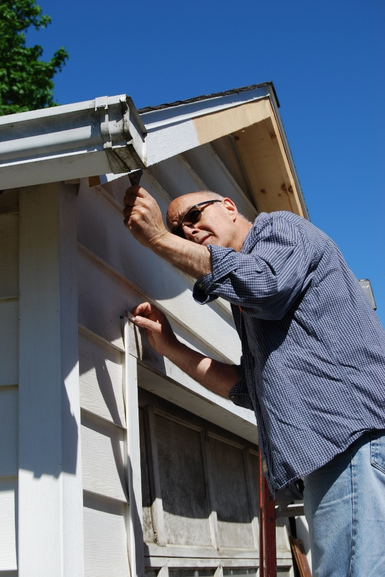
VOLUNTEER ORIENTATION
All volunteers are required to view this orientation. At the end of this presentation, you will be asked to verify that you completed the requirement.
Thank you for volunteering!

Slide 2
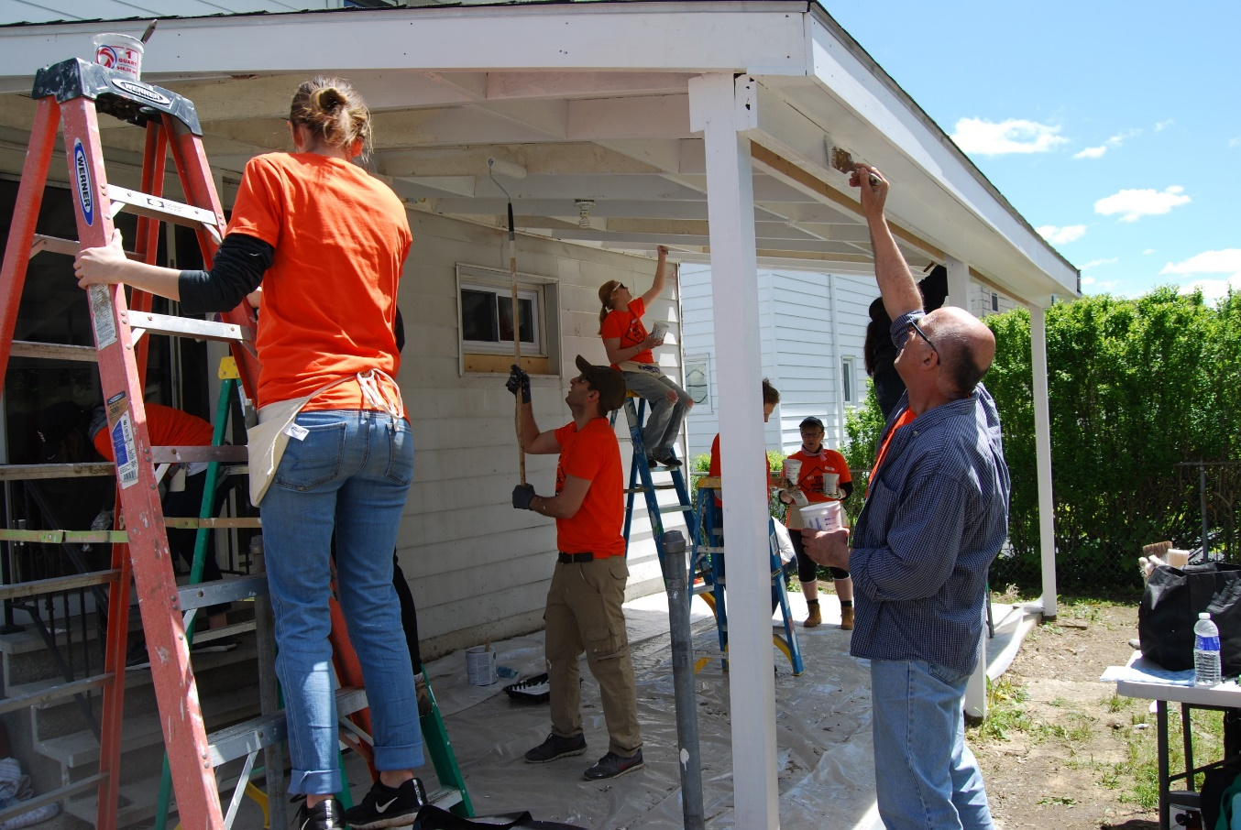
You are Part of a Larger Effort
Each year, across all Habitat for Humanity organizations,
we…
Mobilize millions of people to join the cause of affordable shelter.
Help more than half a million people around the world improve their shelter situation.

Slide 3
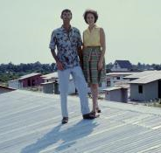
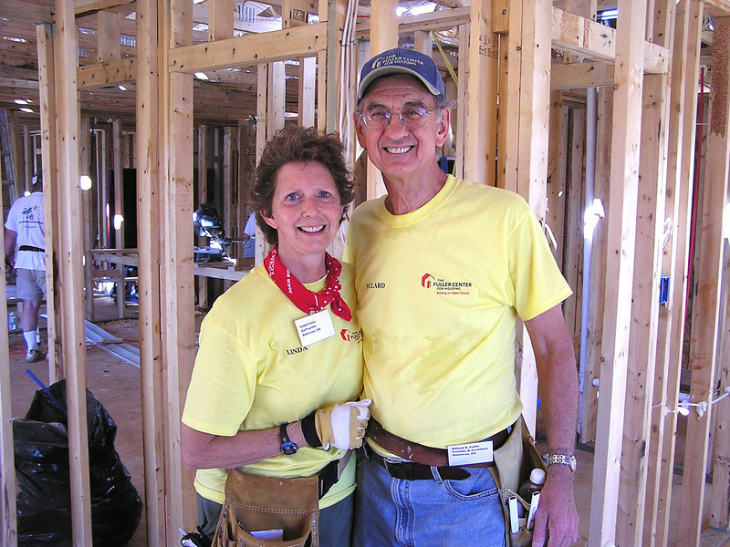
A Brief History
Habitat for Humanity is a worldwide,
nonprofit, non-proselytizing,
ecumenical Christian organization.
Started in 1976 by Millard and Linda
Fuller at Koinonia Farms
Jimmy and Rosalynn Carter
got involved in 1984.
International headquarters in
Americus, Georgia.

Slide 4
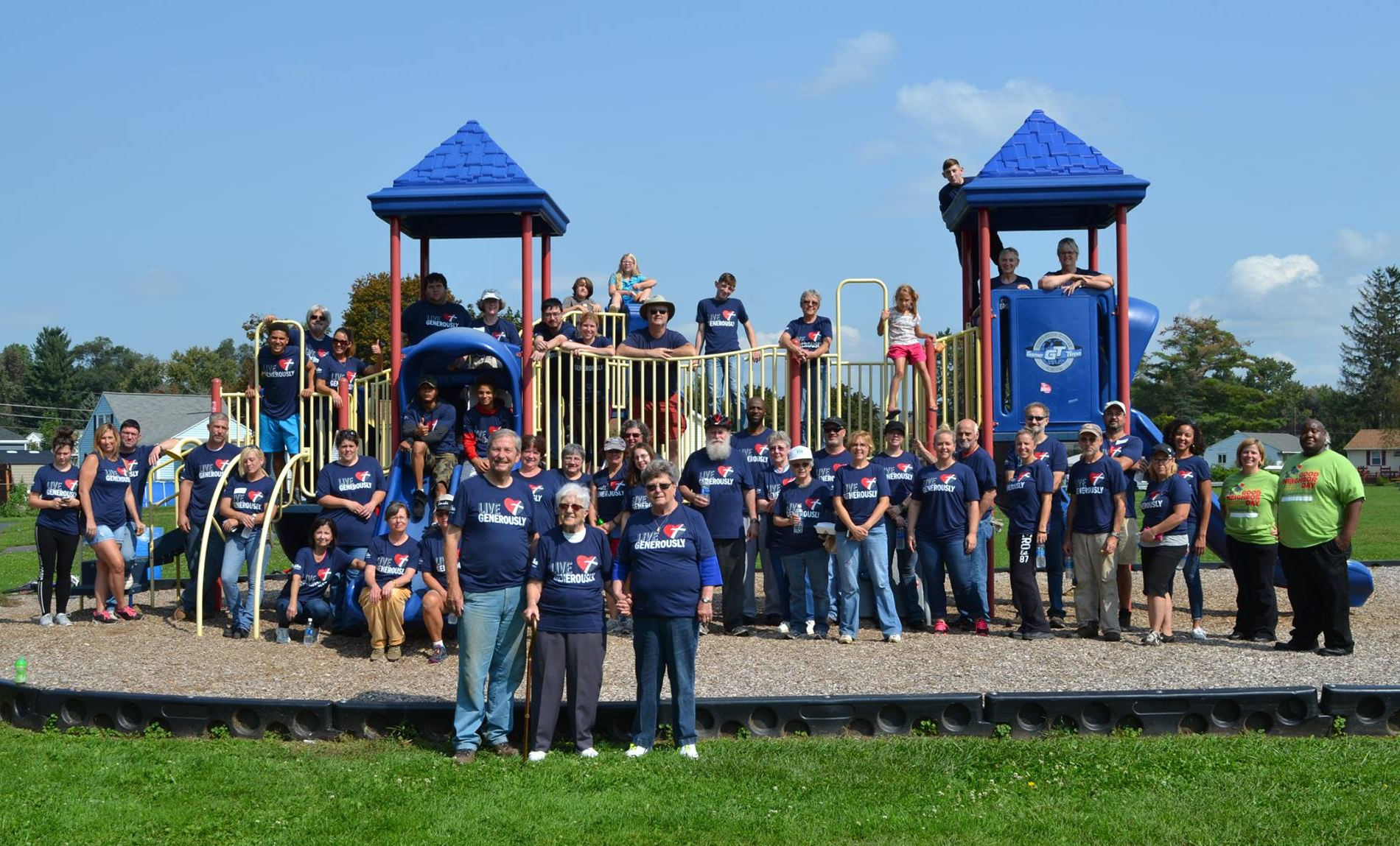
At Work in Chemung County…
Chemung County Habitat for Humanity began in 1989.
We provide homes to low-income families in need.
We organize volunteer events such as:
  Woman Build and
  Cities RISE neighborhood clean up
We coordinate hundreds of local
volunteers at our build sites
every year.

Slide 5
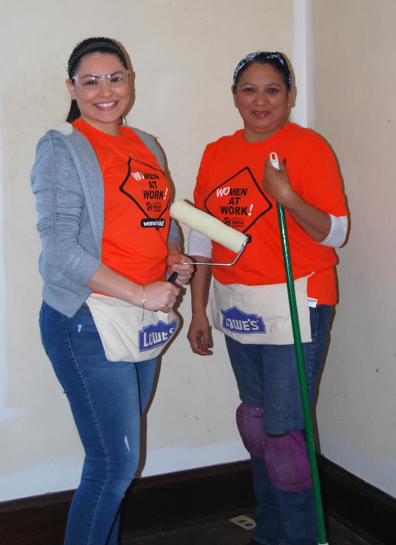
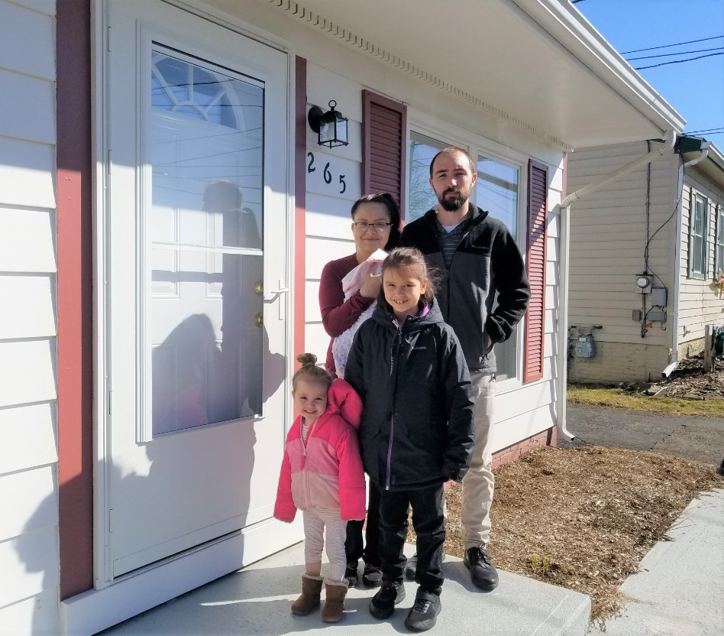
Our Partner Families…
Partner Families are selected based upon the following three criteria:
  Need – The family has a need for safe and affordable housing.
  Ability to pay – They have the ability to save for a down payment and pay an affordable mortgage.
  Willingness to partner with us – Must perform at least 250 hours of Sweat Equity and attend an approved homebuyer education class.

Slide 6
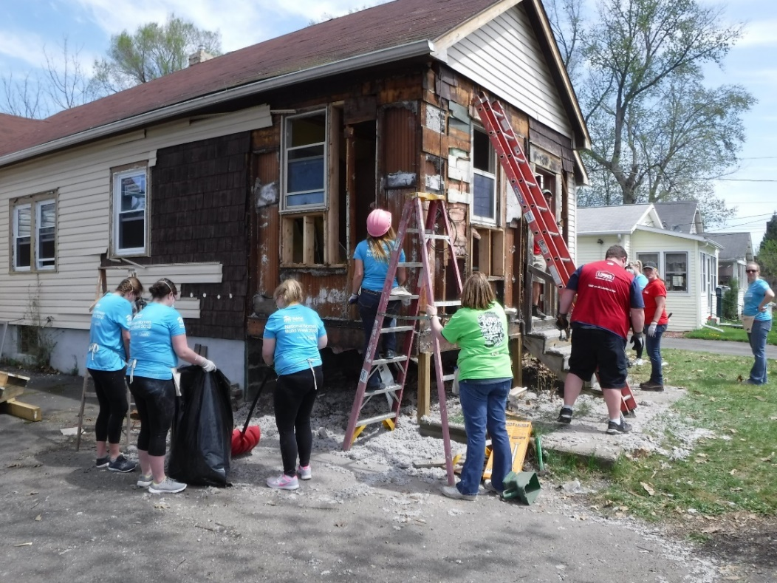
How You Can Help
Habitat relies heavily on volunteers to help us build safe, affordable housing for families in Chemung County.
Donations are a vital part of our
organization. Chemung County Habitat
for Humanity accepts donations of cash,
tools and construction materials.
Click here to donate:
https://chemungcountyhabitat.org/donate

Slide 7
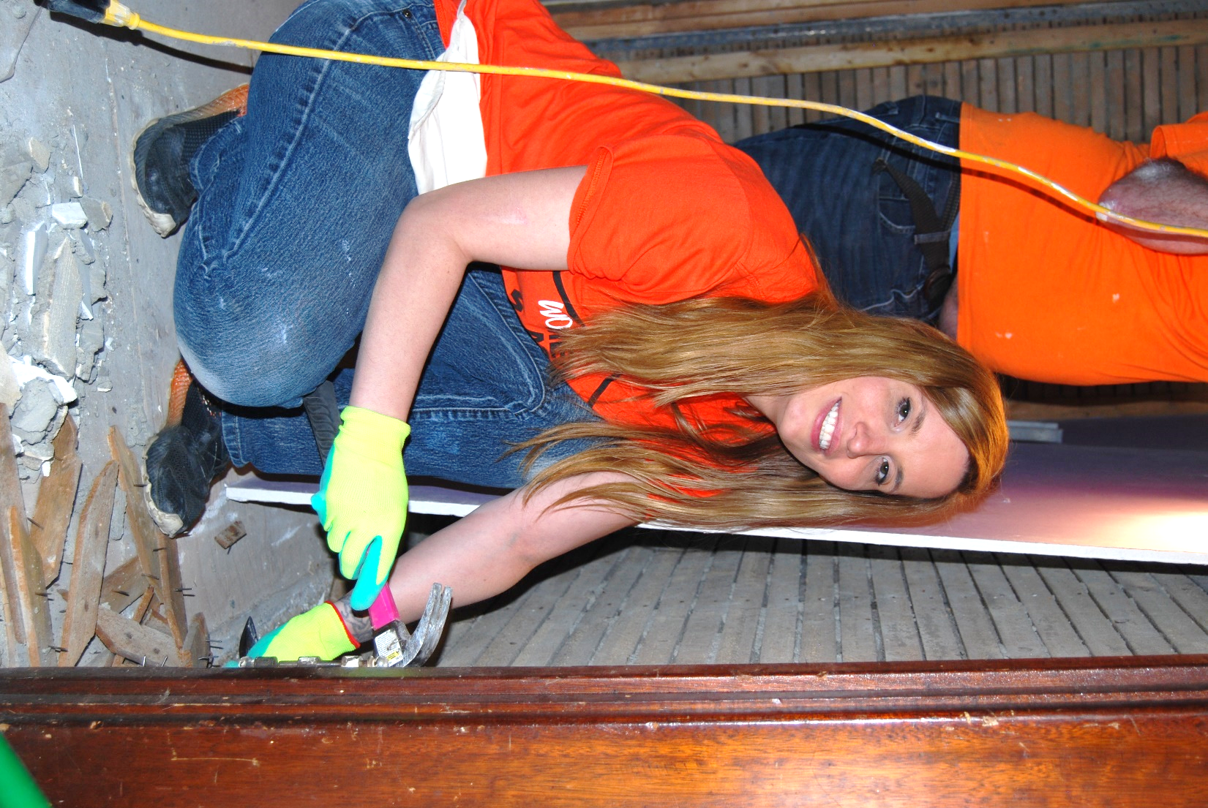
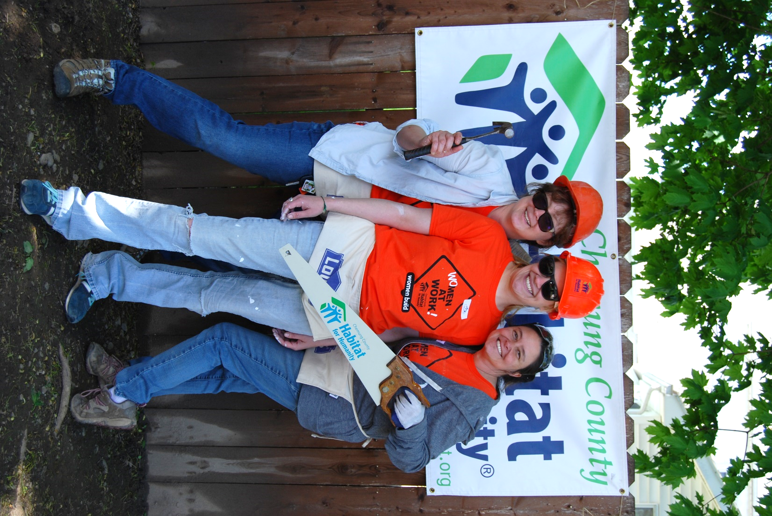
Volunteering
Community groups, individuals,
and corporate groups are
welcome to volunteer with us.
Benefits of Volunteering
You learn new skills.
You meet new people.
You feel good about helping others.

Slide 8
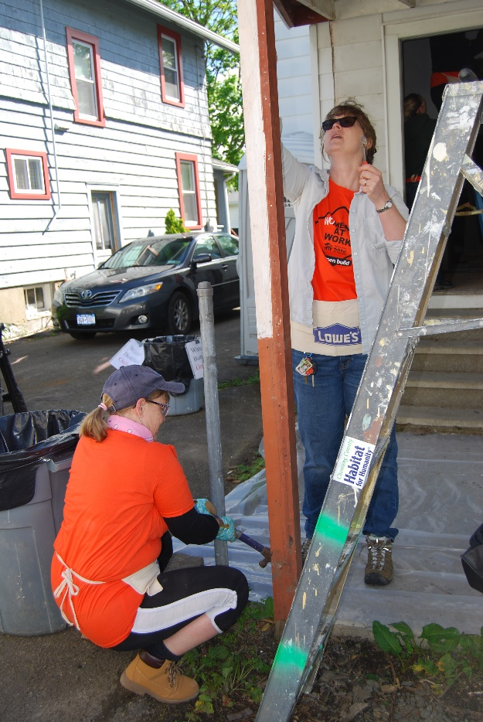
A Typical Day at Our Build Sites
Volunteer workdays are Weekdays and Saturdays by appointment, between 8:30 and 2:30.
Work tasks are chosen or assigned based on the volunteer’s skill level.
Wear clothes that can get dirty.
Personal protection equipment provided.
Age requirements:
18 and older – all tasks permitted.
16 to 17 – construction work, no power tools.
14 to 15 – painting/landscaping away from active construction is happening at site.

Slide 9
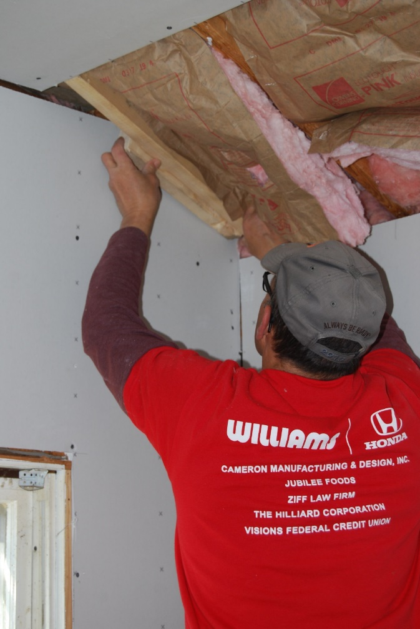
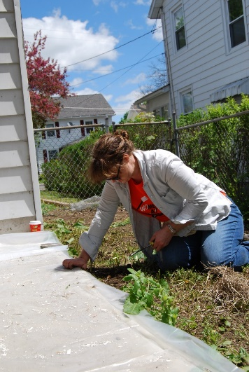
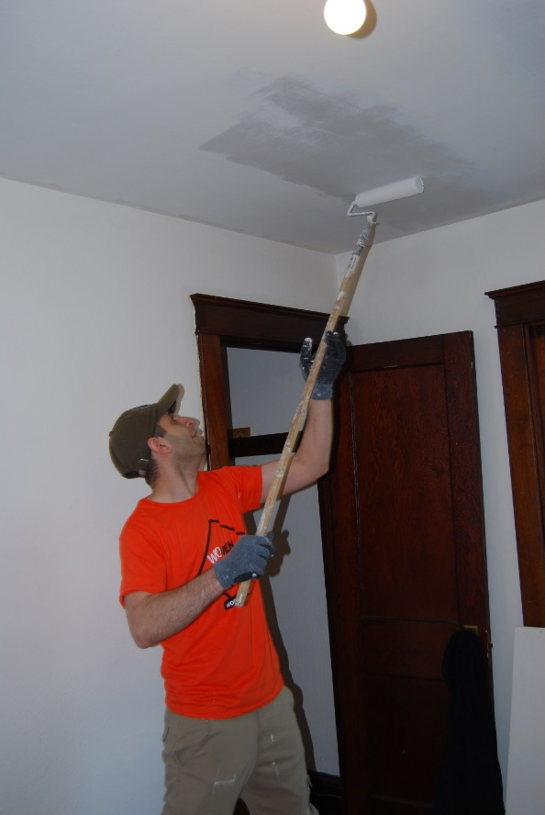
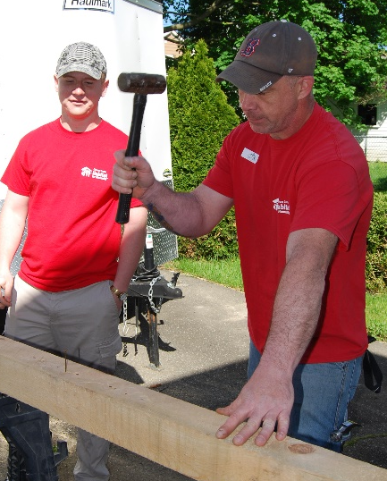
Build Site Volunteer Jobs
General cleaning and clearing of trash and debris
Landscaping
Painting
Carpentry work: drywall, cabinets, doors, framing, installing fixtures.
Flooring
Electrical, plumbing and HVAC

Slide 10
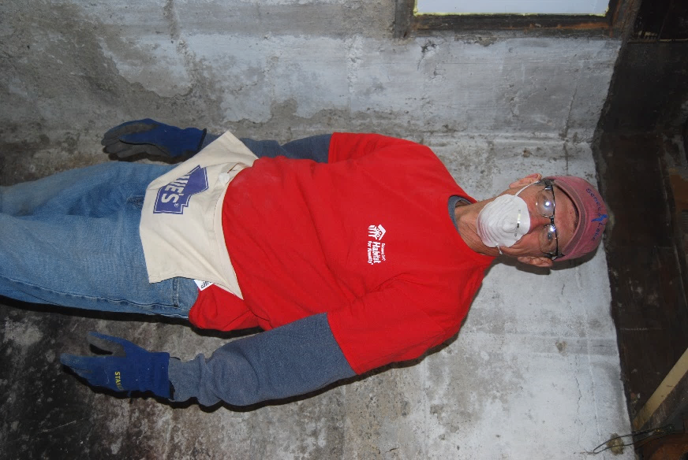
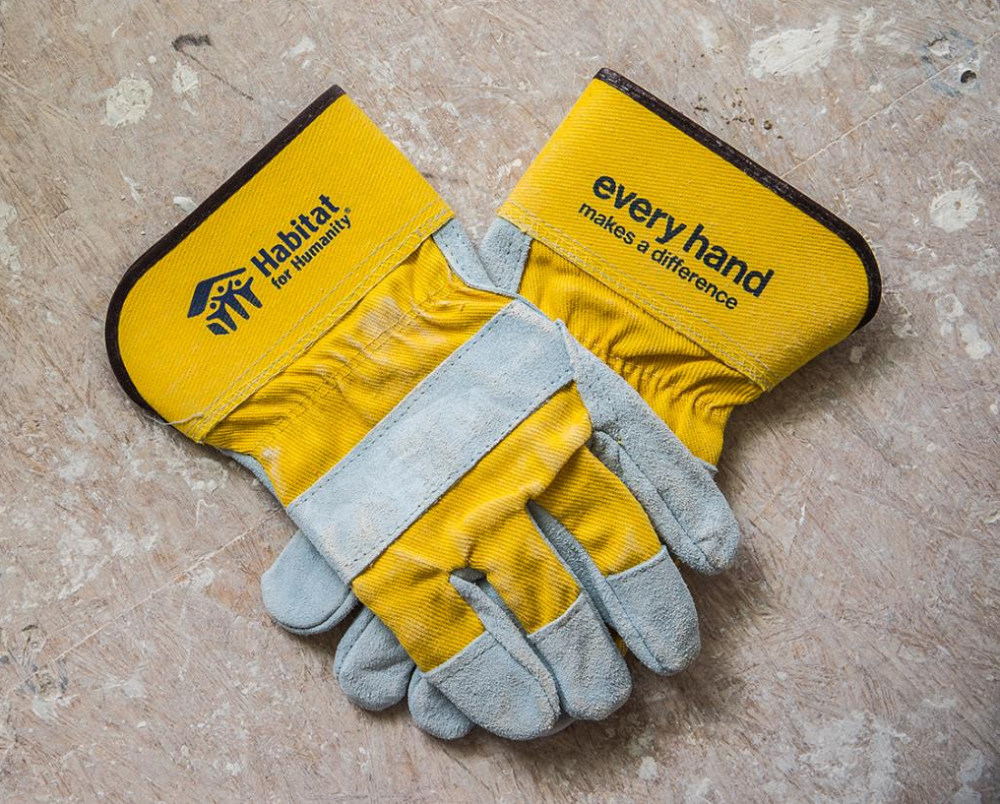
Basic Build Site Safety
Wear old clothes that can get dirty; long pants recommended.
Wear gloves.
Wear goggles when working with power tools.
Wear a mask when working with dust, mold, or trash.
Do Not wear open toe shoes.
Do Not place tools/power cables in walkways or in front of stairs where others could trip.
If you’re not sure how to use a tool…ask. We’ll be happy to teach you.
Do Not leave tools on top of ladders.
Wear hard hats when you or others are working above head level with heavy/dangerous materials or tools.
Make sure ladders are secure and/or have another person holding the base.

Slide 11
Volunteering at Our Office
Office volunteers can help with data entry, mailings, etc., depending on skills.
By appointment
Attire is business casual.
Email: info@chemungcountyhabitat.org
Located at: 219 E. 14th St
Elmira Heights, NY 14903
Phone: (607) 734-1361, option 3

Slide 12
Expectations for Volunteers
Habitat for Humanity International adheres to a
Volunteer Code of Conduct with an emphasis on the following areas:
  Promoting a respectful community
  Prioritizing site safety
  Upholding a zero-tolerance policy for alcohol, drugs and weapons
  Model behavior that respects the human rights of all people.
  Safeguarding Habitat for Humanity assets
  Maintaining confidentiality

Slide 13
Your Volunteer Commitment
Habitat welcomes volunteers who can make a one-time or
regular commitment… all day or just a few hours. We’re flexible about working within your time constraints.
Keep in mind that once you are scheduled to volunteer, our construction staff plans accordingly. If you need to cancel, just let us know!

Slide 14
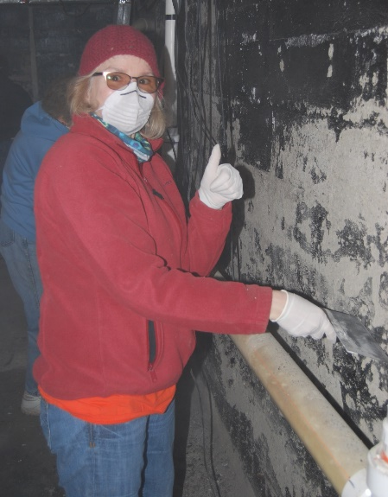
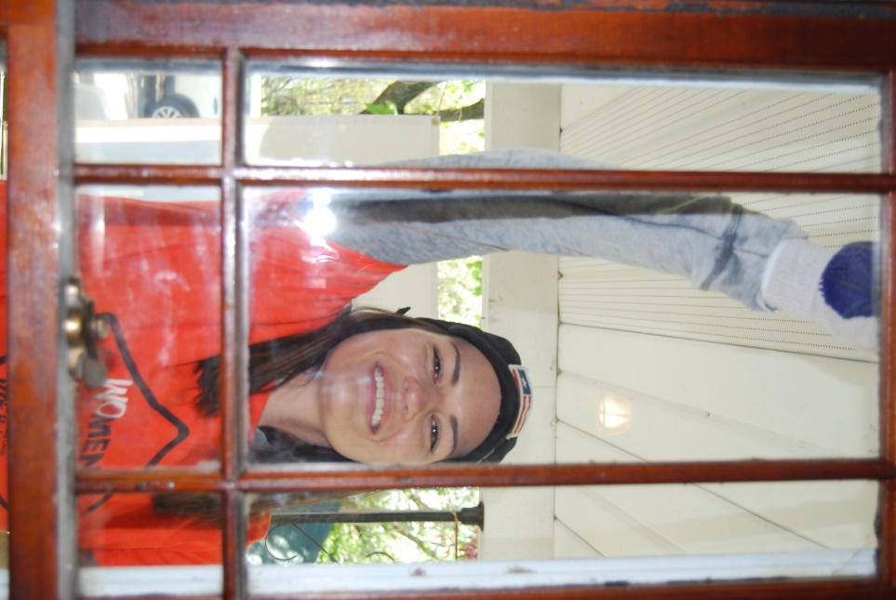
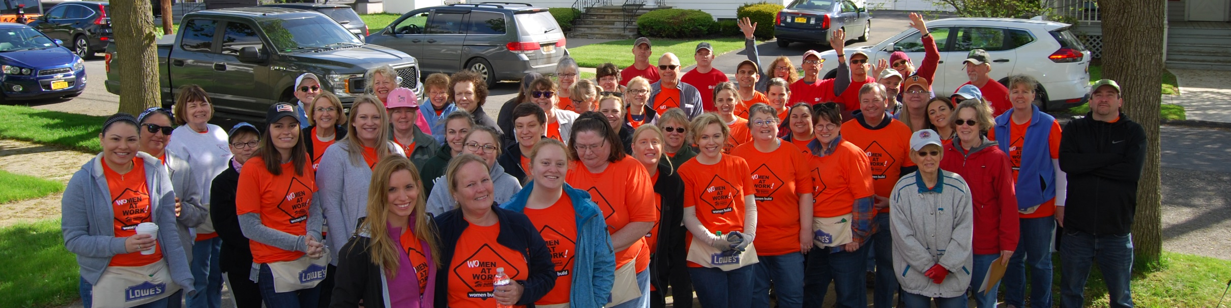
Let’s Get Started!
Join hundreds of other Habitat volunteers
who hep us build homes, communities and hope! Sign up to be a volunteer today.
One more step: Verify completion of
this orientation on the next page, and we will reach out to you to schedule a time to volunteer.

Slide 15


Thank you for choosing to volunteer with Habitat for Humanity!
To verify completion of this orientation, click here: https://form.jotform.com/92393689276172
“Volunteers do not necessarily have the time; they just have the heart.” ~Elizabeth Andrew

